Slide 1
Web Programming 1
Worksheet 7 - Implementing MovieFinder

Slide 2
Code overview
Create new project – week 7, “movie-finder”
An interface file will mirror the shape of the data we will consume from the external API
A service file will do an API call using a HTTP GET - looking for a movie title.
This returns an observable with the response – but this reponse might also be an error!
To get the data in the observable we must subscribe to it – eventually, hopefully, it will emit an event in the form of our interface
We display the data in our template

Slide 3
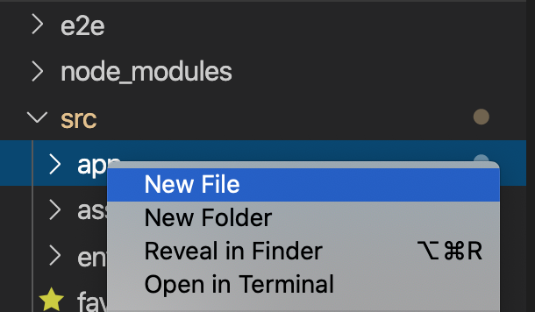
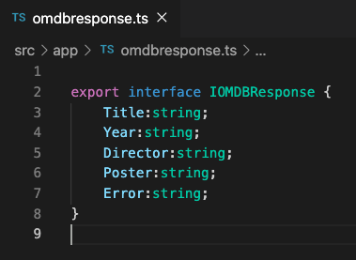
The Code
Create a new Angular application called movie-finder
ng new movie-finder
Now create an interface file called omdbresponse.ts
Within src/app/ - right click and add new file
Add this code

Slide 4
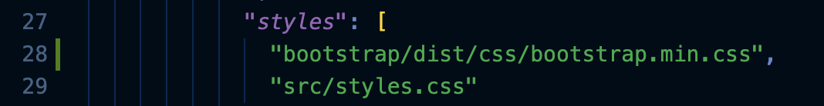
The Code
Install bootstrap –
npm install bootstrap
Modify angular.json by adding reference to bootstrap
Now create a service file omdb-api in a “services” directory
ng generate service /services/omdb-api
Modify the code in the service file as per next slide

Slide 5
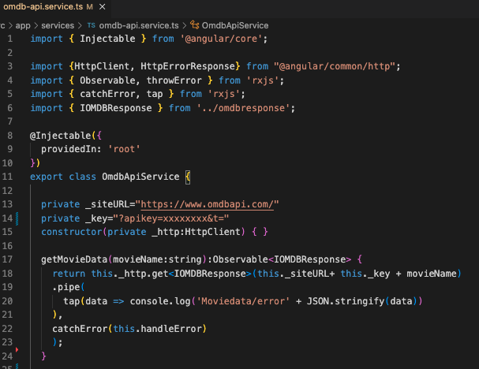
The Code
Add these
To deploy on firebase hosting – this should
Be https
Add getMovieData method
Add your own API key
from OMDBApi.com
You will get an a compile error here – catchErrors has not been defined yet….

Slide 6
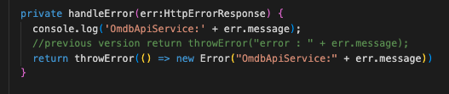
Finally Add handleError to the service as well

Slide 7
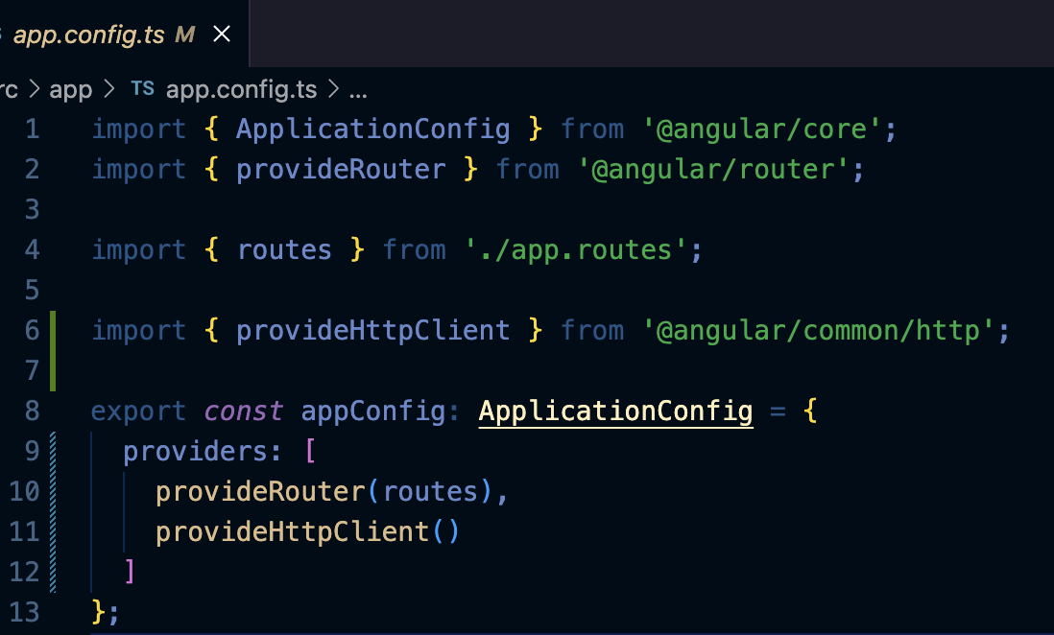
HTTP Service Provider Registration
Using HTTPClient has changed with Angular 17 and standalone components.
We need to modify app.config.ts and reference to HttpClient
1 - We import providedHttpClient
2 - We add it as a provider
1
2

Slide 8
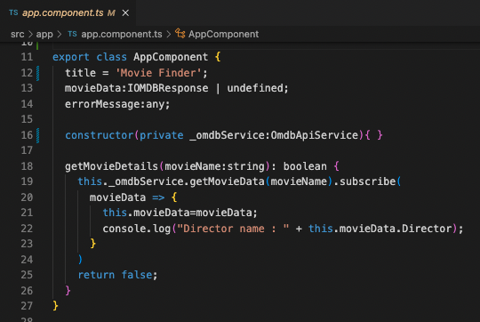
Subscribing to an Observable
The product data service is now returning an observable
Any class that needs movie data such as our app component, can call our service and subscribe to the returned observable
Observables are lazy.
An observable doesn't start
emitting values until
subscribe is called.

Slide 9
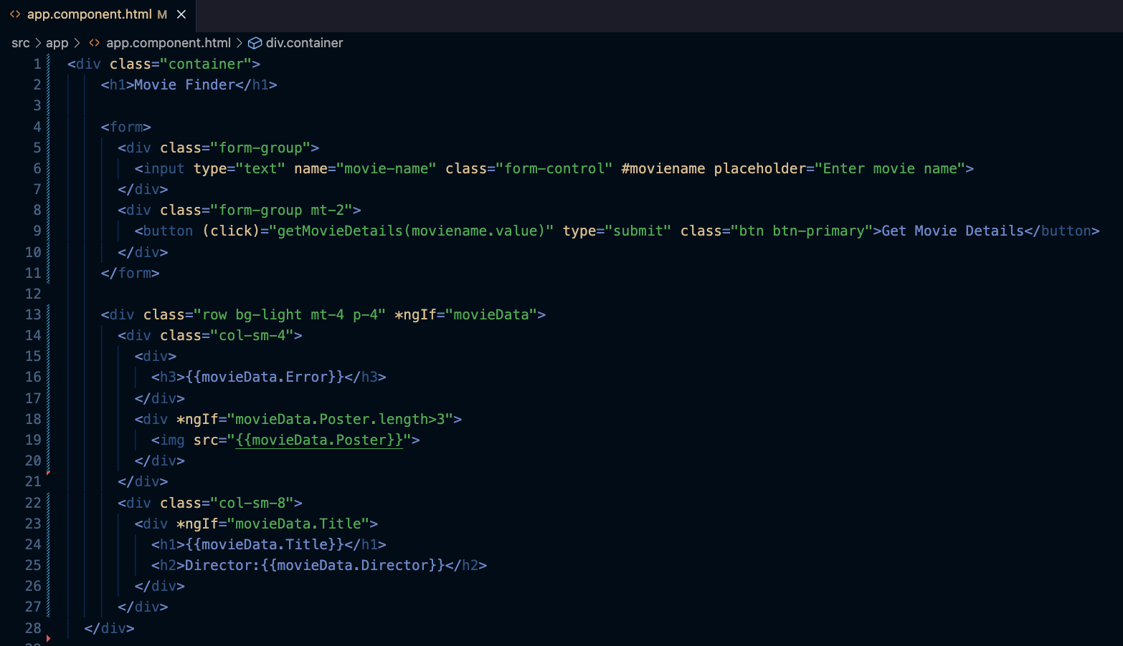
Modify app.component.html

Slide 10
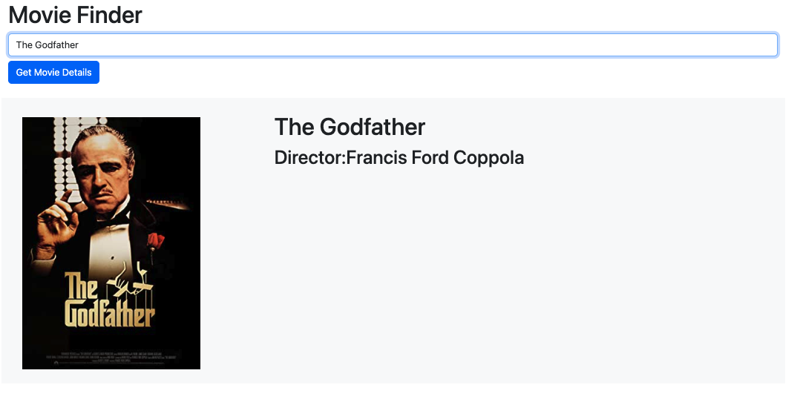

Slide 11
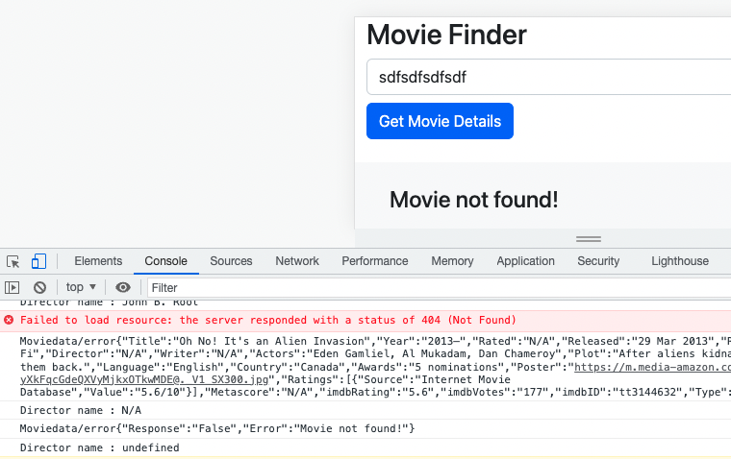

Slide 12
Further potential improvements
Do a search on the movie “Fahrenheit”. It does not have a poster – what does it return in the .Poster property? How will your app deal with no poster image to display?
You want to display reviews from the 3 most popular review sites. How might you go about this?
We want to change the parameter from being a search on a movie title (returns 1 movie) to being a general search (potential to return many movies). What changes will we need to make?
Let’s do 3 next week

